Slide 1


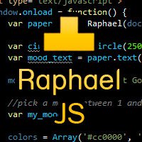

Team “Kia”

Slide 2
Мирослава Иванова – BaklavaBg
Diana Pesheva – dpesheva
Михаил Каличков– mihailkalichkov
Цанко Андреев– tsankoandreev
Веселин Павлов- vtpavlov
Никола Тодоров- nmtodorov
Team members

Slide 3
Goals
To create a Mind map JavaScript application using the HTML graphic APIs – canvas and SVG
To use …. framework
To implement interaction with the user
To use the best practices for producing high-quality code
……

Slide 4
Project: MindMap
….short description……..
….screenshot……..

Slide 5
Project: MindMap
….additional details and screens……

Slide 6

Realization
All requirements about this project are fulfilled :
Use HTML5 Canvas
Use SVG
Create animation
……….

Slide 7
Realization
….Class Diagram…..

Slide 8
..few words about the team work….
… a funny picture to make them laugh….

Slide 9
Thank you for your attention!

